Slide 1
PARKING SPACE DETECTION USING YOLOv8
CAPSTONE PROJECT
Presented By:
Student Name- YASHITHA S
College Name- AMC ENGINEERING COLLEGE
Department- CSE(DATA SCIENCE)

Slide 2
OUTLINE
Problem Statement
Proposed System/Solution
System Development Approach
Algorithm & Deployment
Result
Conclusion
Future Scope
References

Slide 3
Problem Statement
.
Urban areas face parking congestion due to increasing vehicle population.
Drivers waste significant time searching for available parking spaces.
Manual monitoring of parking lots is inefficient and error-prone.
Lack of real-time parking availability information leads to traffic congestion and fuel wastage.
Existing systems are costly as they rely on hardware sensors for each parking slot.

Slide 4
Proposed Solution
Develop a Computer Vision-based Parking Space Detection System using OpenCV.
Capture parking lot images or video feed through a camera.
Mark parking slots using a slot selection tool.
Process each frame to detect whether a slot is Occupied or Free.
Display real-time slot status and count of available spaces.
Provide a cost-effective solution without requiring physical sensors.

Slide 5
System Approach
Data Acquisition
Capture parking lot images or real-time video using a CCTV/camera feed.
Parking Slot Selection
Manually mark parking spaces using a slot selection tool.
Store slot coordinates for further processing.
Pre-Processing
Convert frames to grayscale.
Apply Gaussian blur to reduce noise.
Perform thresholding to highlight vehicles.
Feature Extraction
Extract Region of Interest (ROI) for each marked slot.
Analyze pixel intensity to detect vehicle presence.
Classification
If pixel count exceeds threshold → Occupied
If pixel count is below threshold → Free
Visualization & Output
Display real-time results with colored bounding boxes.
Show total number of available and occupied spaces.

Slide 6
Algorithm & Deployment
Start
Capture video frame from camera or load parking lot video.
Load saved parking slot coordinates.
For each frame:
Convert image to grayscale.
Apply Gaussian Blur to reduce noise.
Perform Adaptive Thresholding to highlight vehicles.
Apply Median Blur & Dilation for better object clarity.
For each parking slot (ROI):
Extract the region.
Count non-zero pixels.
If pixel count > threshold → Mark as Occupied
Else → Mark as Free
Display slot status with colored rectangles.
Show total free parking count.
Repeat for next frame.
Deployment was done loacaly

Slide 7
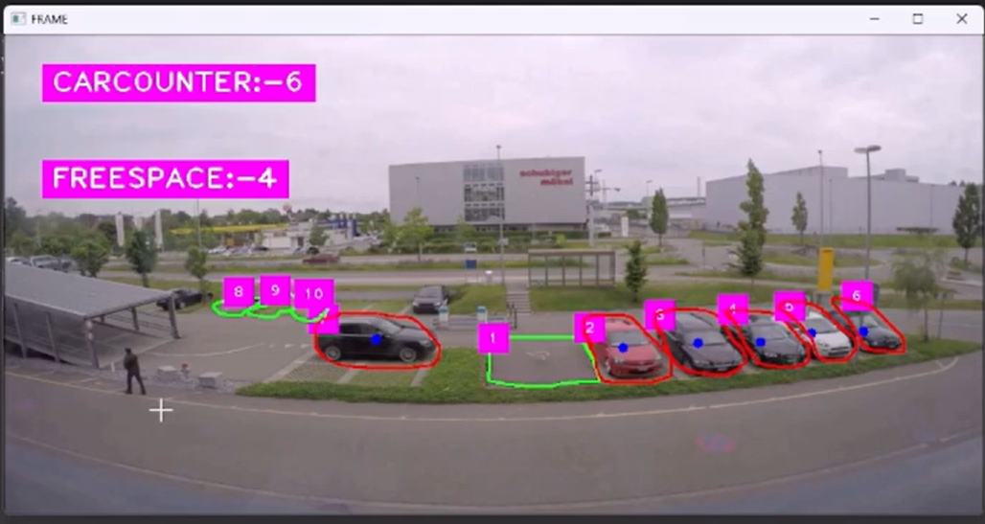
Result
Successfully detected occupied and vacant parking spaces using computer vision techniques.
Real-time processing of video frames with accurate slot classification.
Displayed:
🟢 Free slots (Green bounding box)
🔴 Occupied slots (Red bounding box)
Generated live count of available parking spaces.
Reduced need for manual monitoring.
Demonstrated a cost-effective alternative
to sensor-based parking systems.

Slide 8
Conclusion
Successfully developed a Computer Vision-based Parking Space Detection System.
Accurately classified parking slots as Occupied or Free using image processing techniques.
Provided real-time visualization and slot count display.
Reduced dependency on hardware sensors, making the system cost-effective.
Demonstrated practical application of OpenCV in smart parking solutions.

Slide 9
Future scope
🔹 Implement deep learning models (YOLO / CNN) for higher accuracy.
🔹 Automate parking slot detection (remove manual marking).
🔹 Integrate with a web dashboard for remote monitoring.
🔹 Develop a mobile application to show live parking availability.
🔹 Store historical data for analytics and smart traffic management.
🔹 Deploy in real-world environments like malls, campuses, and smart cities

Slide 10
References
OpenCV Official Documentation – https://opencv.org/
NumPy Documentation – https://numpy.org/
Python Software Foundation – Python Documentation – https://docs.python.org/
Research papers on Smart Parking Systems using Computer Vision
Online tutorials and GitHub repositories related to parking space detection

Slide 11
Github link
Github Link : https://github.com/yashithaibmskillsbuild-netizen/AICTE-TASK-PARKING-SPACE-DETECTION-

Slide 12
THANK YOU

